Slide 1
Veritas Bank Executive REPORT: ANALYZING CUSTOMER CHURN & RETENTION PATTERN-A NEED TO ACT FAST
Presented by: group 3 data analysis January 2026 consultants
Notes:
AI-generated content may be incorrect. ---

Slide 2


TITLE SLIDES
Slide Content:
Introduction
Business Problem
Data & Methodology
Dashboard Presentation & Analysis
Key Insight: Age & Churn, Balance & Churn
Business Impact
Recommendation
Conclusion
Notes:
Introducing Veritas Bank: Vision, Mission and Brand Identity Retail Banking Services and Solutions Client Relationship Management and Experience Corporate Responsibility and Future Outlook

Slide 3
Introduction
Who is Veritas Bank ?
Veritas Bank is a third generation UK-based multinational bank focused on providing premium value optimized by technology and superior customer service to its customers. Serving over ten thousand customers cut across key European countries the bank has been a pioneer in developing retail banking services such as personal loans, digital banking services amongst others to its customers.
Notes:
Introducing Veritas Bank: Vision, Mission and Brand Identity Retail Banking Services and Solutions Client Relationship Management and Experience Corporate Responsibility and Future Outlook

Slide 4

What is Customer Churn?
Customer Churn refers to a situation where customers prefer to close their accounts or decide to stop using services provided by a bank.
Why Customer Churn matters in banking
Customer Churn matters in banking especially in retail banking because the cost of acquiring new customers far outweighs the cost of retaining existing customers. It has the potential to portray the bank as an organisation that does not care about its customers.
Objectives of the analysis
The objective of the analysis carried out on the bank is to identify pattern behind customer churn and suggest data-driven solutions that arrest this challenge.
Notes:
--- Founded in the early 2000s, Veritas Bank has grown from a regional financial institution to a nationally recognized retail bank, anchored by core values of integrity, reliability, and customer focus. The bank's commitment to ethical banking practices and community engagement has fostered steady growth, achieving a compound annual growth rate of over 15% in its customer base over the last decade. Veritas Bank has continually adapted to market changes while maintaining a stable governance structure and transparent operations. Image source: AI-generated

Slide 5

Business problem
Increasing Customer Exist
Customer exits have been increasing across certain segments of Veritas Bank’s customer base. Though exiting customers poses a less significant threat when considered individually as their bank account balances reveals. However, if such exit is not addressed has the potential to harm the bank in the long term. An increasing churn rate signals dissatisfaction, competitive pressure, or service gaps that require urgent attention.
Declining long-term profitability
If churn continues to rise, Veritas Bank may experience declining customer lifetime value, increased marketing expenditure to replace lost customers, and reduced overall profitability.
Need for data-driven retention strategy
The strategy used by many banks is to try and retain customers when they become dissatisfaction becomes very visible. However, a data-driven retention strategy allows the bank to identify high-risk customers before they exit. By utilizing predictive analytics, machine learning and customer segmentation, Veritas Bank can proactively intervene with personalized offers, improved service engagement, and targeted incentives.
Notes:
--- Veritas Bank’s vision centers on becoming the most trusted retail banking partner by delivering innovative financial solutions with exemplary service. Its mission emphasizes empowering customers through tailored products, embracing digital transformation, and cultivating long-term relationships based on transparency and respect. Studies show that banks with clear, customer-centric vision and mission statements improve employee engagement by up to 30% and customer loyalty significantly. Image source: AI-generated

Slide 6

Data & methodoly
Customer Demographics: Age, gender, and geographic location to understand segment-level behavior.
Account Balance: Customer balance levels to assess financial value and commitment to the bank.
Tenure: Length of time with the bank to evaluate loyalty and lifecycle stage.
Product usage: Depth of product usage (e.g., credit cards and other services) to measure relationship strength.
Credit score: Credit score categories to understand financial stability and risk exposure.
Churn status (Exited / Retained): Final outcome used to compare retained customers against those who left.
Notes:
--- Veritas Bank’s cream and light blue color scheme embodies sophistication, trust, and harmony—qualities that resonate strongly in financial services branding. Research indicates that blue hues improve perceived reliability and security, critical in banking, while cream tones add a sense of calm and professionalism. This color palette supports consistent brand recognition across digital, print, and branch environments, reinforcing customer confidence. Image source: AI-generated

Slide 7
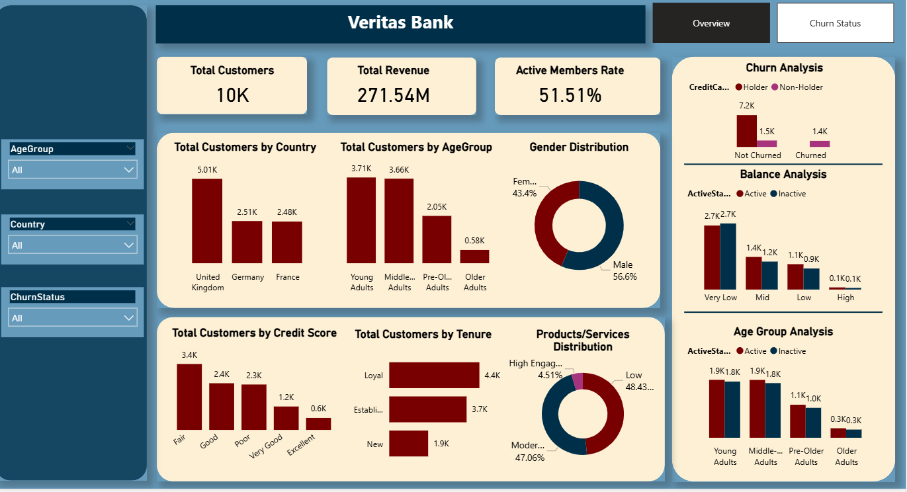
Notes:
--- Veritas Bank offers a comprehensive range of personal banking products, including checking and savings accounts, personal loans, mortgages, and credit cards featuring competitive interest rates and flexible terms. According to recent market analysis, the bank’s personal loan portfolio grew by 12% year-over-year, driven by tailored lending criteria and enhanced customer underwriting processes. Product bundling strategies have increased cross-selling rates by 25%, improving customer lifetime value. Image source: AI-generated

Slide 8
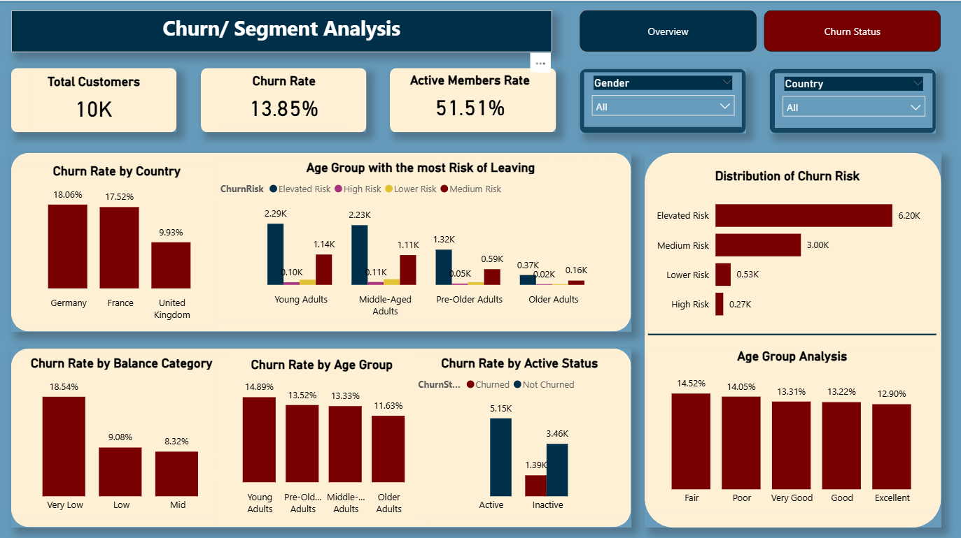
Notes:
--- Veritas Bank offers a comprehensive range of personal banking products, including checking and savings accounts, personal loans, mortgages, and credit cards featuring competitive interest rates and flexible terms. According to recent market analysis, the bank’s personal loan portfolio grew by 12% year-over-year, driven by tailored lending criteria and enhanced customer underwriting processes. Product bundling strategies have increased cross-selling rates by 25%, improving customer lifetime value. Image source: AI-generated

Slide 9
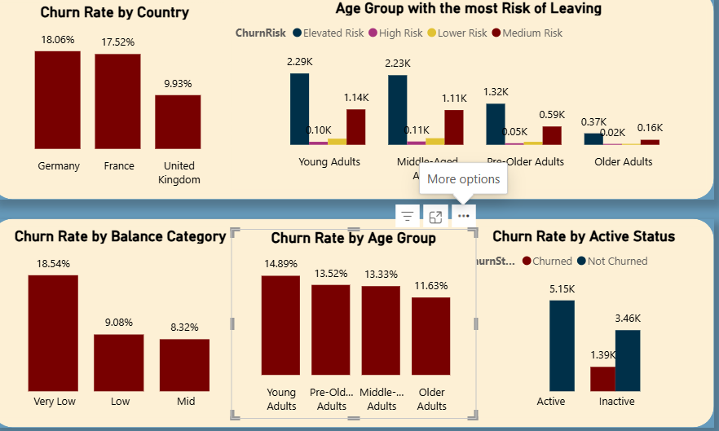
Key insight-age & churn
Male constitute 56.6% of the gender makeup with women and young girls taking up 43.4%. This shows that gender makeup is slightly skewed to the male gender.
However, Middle-aged customers show relatively higher churn levels.
Younger customers demonstrate stronger retention stability. This is shown from the dashboard as young adults customers make up more than 50% of the demographic setup.
Age-related financial needs may influence switching behaviour.
Notes:
--- The bank’s digital banking platforms serve over 70% of customers monthly through mobile apps and online portals, offering 24/7 account access, bill payments, and personalized financial management tools. User satisfaction ratings for mobile banking surpassed 90% in independent surveys, reflecting ease of use and robust security features, including biometric authentication and real-time fraud monitoring. Digital adoption accelerated by 40% during the pandemic, underscoring the importance of seamless online experiences. Image source: AI-generated

Slide 10
Insight: Balance & churn
High-balance customers exhibit notable churn risk
A significant proportion of customers hold very low balances, while high-balance customers are limited.
The customer base is heavily weighted toward low-value accounts, indicating opportunity to grow balances and deepen financial relationships.
Financial value does not guarantee loyalty
Although high-balance customers contribute significant deposits, balance size alone does not ensure loyalty.
Customers may hold large funds but still switch banks if they perceive better value elsewhere.
Dissatisfaction may exist despite strong deposits
Strong deposits may mask underlying dissatisfaction.
If service quality or product offerings do not meet expectations, even high-value customers may choose to leave.
Notes:
--- Innovations like AI-powered personal financial advisors, real-time spending notifications, and customizable account alerts exemplify Veritas Bank’s customer-first approach. Over 60% of users engage monthly with these features, improving financial literacy and budgeting discipline. The bank’s innovation lab collaborates with fintech startups to pilot emerging technologies, contributing to a 15% increase in product innovation index scores compared to peers. Image source: AI-generated

Slide 11

INSIGHT: TENURE & Loyalty
Tenure & Loyalty
A large proportion of customers are in the early stages of their relationship.
New customers are more vulnerable to early exit.
Retention improves with longer relationship duration.
Early engagement is critical.
Early-life customers represent a significant share of the base, increasing exposure to early churn. Strengthening onboarding and first-year engagement could materially reduce attrition.
Customers in the early stages of their relationship are more likely to churn, highlighting weaknesses in onboarding or early engagement. As tenure increases, stability improves, reinforcing the importance of strengthening the first-year experience.
Notes:
--- The bank’s loyalty program includes points on debit and credit card spending, cash-back offers, and exclusive partner discounts, enhancing customer stickiness. Data shows members of loyalty programs have a 35% higher product holding rate and 22% greater account longevity. Seasonal promotional campaigns and tiered rewards increase program engagement, contributing to an average 10% revenue uplift per loyalty segment annually. Image source: AI-generated

Slide 12

BUSINESS IMPACT
Direct revenue and deposit loss
Increased cost of acquiring replacements
Lower long-term customer lifetime value
Reduced cross-selling potential
Churn impacts the bank financially in multiple ways — not just through immediate deposit loss, but through reduced lifetime value and higher marketing costs required to replace exited customers.
Notes:
--- Regular customer satisfaction surveys reveal a Net Promoter Score (NPS) consistently above 50, indicating strong advocacy. Support services operate via multi-channel systems including chatbots, phone, and in-branch assistance, resolving over 85% of inquiries on first contact. Veritas Bank employs agile feedback loops to integrate customer insights into product development, reducing time-to-market by 25% for new features. Image source: AI-generated

Slide 13

RECOMMENDATION
Introduce loyalty incentives for high-balance customers
Strengthen onboarding and early-life engagement programs
Deploy personalized product offers based on behaviour
Implement predictive churn modelling for early intervention
These recommendations focus on both prevention and strategic growth — protecting high-value segments while strengthening engagement among vulnerable customers.
Notes:
--- Veritas Bank maintains rigorous compliance with regulatory standards and an open disclosure policy about fees and practices. Ethical banking initiatives include responsible lending, anti-money laundering programs, and transparent communication with stakeholders. Annual transparency reports and third-party audits affirm the bank’s dedication to trustworthiness, with a 95% compliance rating in the latest regulatory review. Image source: AI-generated

Slide 14
Conclusion
Data-driven retention is a strategic necessity
Data driven retention is a proactive strategic tool to reduce churn and improve customer satisfaction.
High-risk segments have been clearly identified
High risk segments have been identified and management should devote resources to develop products to meet and exceed their expectations.
Targeted interventions can significantly reduce churn
The analysis demonstrates that churn is not random. By focusing on identified risk segments and implementing proactive strategies, Veritas Bank can materially improve retention and protect long-term profitability.
Notes:
In summary, Veritas Bank embodies a strong vision and brand identity, delivering innovative personal and digital banking solutions. The bank's personalised customer service, loyalty programmes, and commitment to ethical practices reinforce its dedication to clients and communities. Looking forward, Veritas Bank is well-positioned for sustainable growth and continued excellence in retail banking.

